Slide 1
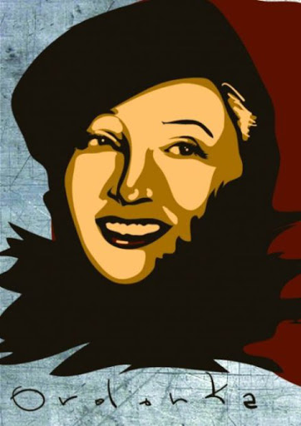
HANKA ORDONÓWNA
„LOVE FORGIVES YOU EVERYTHING”

Slide 2
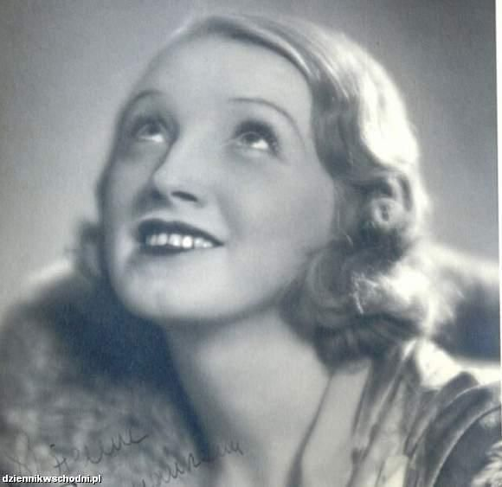
Singer, dancer, actress, author of poems and song texts –
Hanka Ordonówna was born on August 4, 1902 in Warsaw. She was the only child, the daughter of the railway-man and a housewife.

Slide 3
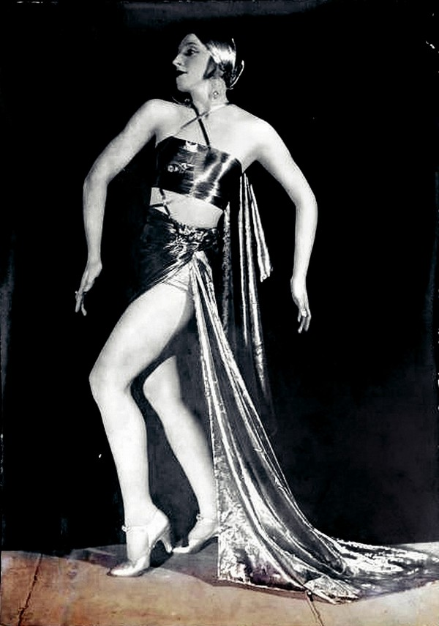
When she was only 6, she started the ballet school in Warsaw.
The sixteen-year-old graduate found work in the theater.
From 1916 she began to use the stage nick „Ordonówna”.

Slide 4
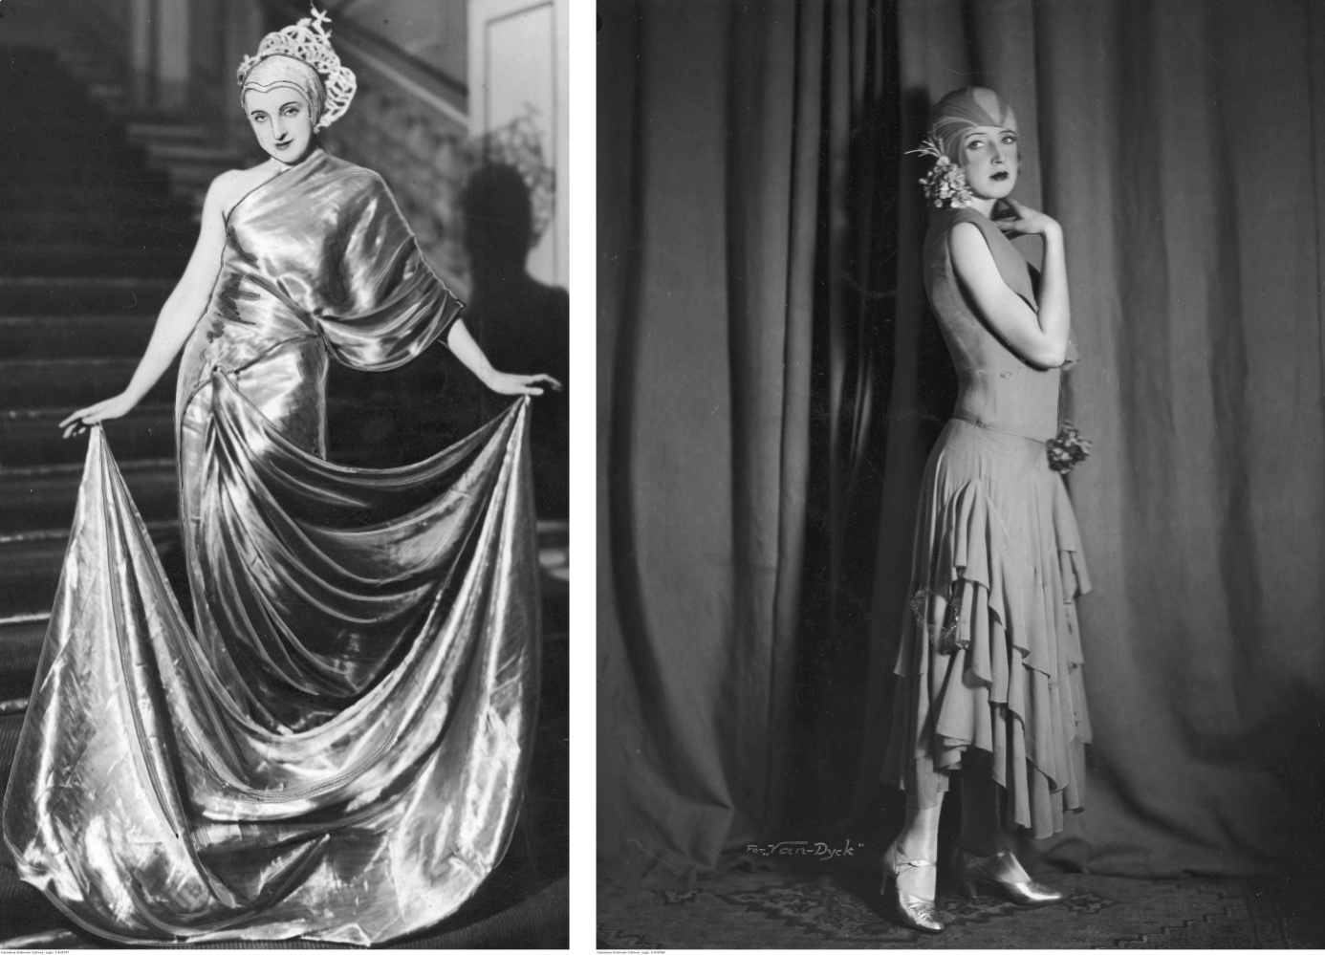
The artist was soon very famous and loved.
She was Polish Josephin Baker or Marlene Dietrich

Slide 5
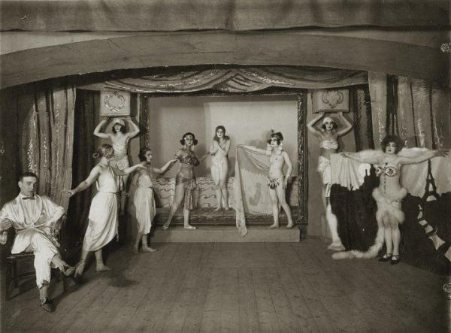
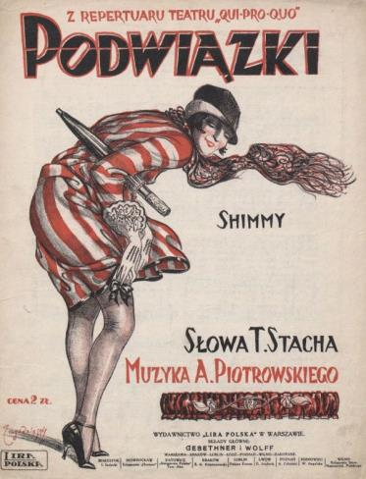
Ordonówna's singing and acting talents developed in the cabaret .

Slide 6
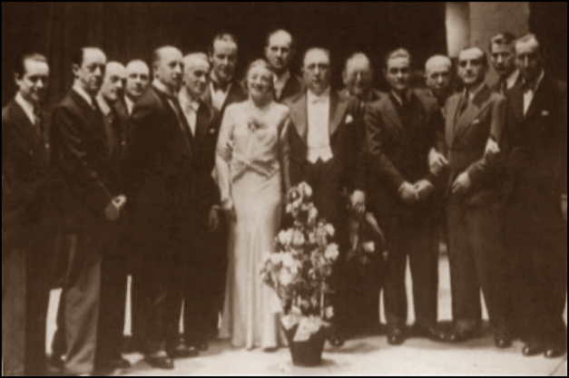
In the cabaret "Qui pro Quo" Ordonówna performed with the most famous artists.

Slide 7
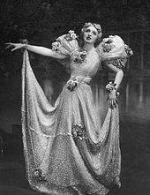
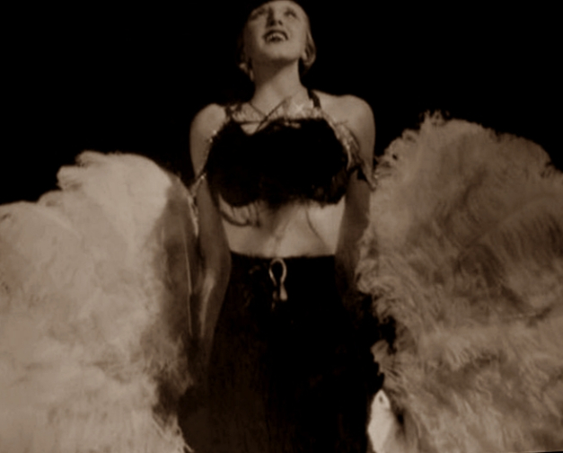
After "Qui Pro Quo" was closed down, she did not work for any theatre. She gave individual recitals. She has performed in Poland and abroad.

Slide 8
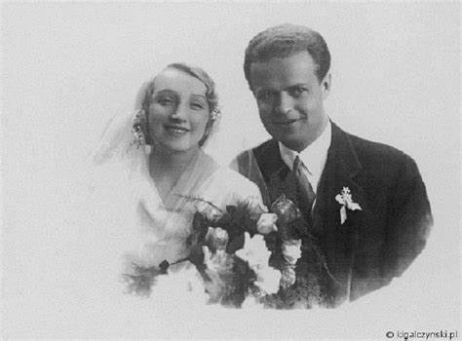
In 1931, she married Count Michał Tyszkiewicz. He wrote the lyrics to many of Ordonka's songs. Unfortunately, the husband's family did not accept Ordonówna, Aristocracy couldn’t marry artists….

Slide 9
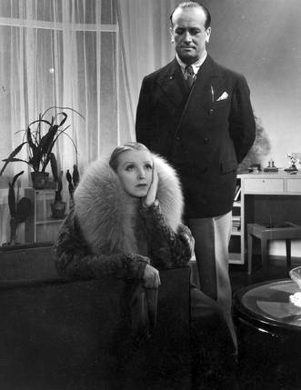
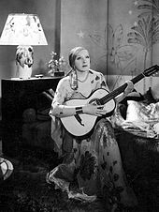
In the 1933 in the film "Spy in the Mask" Hanka Ordonówna performed the hit song „Love forgives you everything” with lyrics by Julian Tuwim. The song made Ordonówna enter the pantheon of pre-war celebrities.

Slide 10
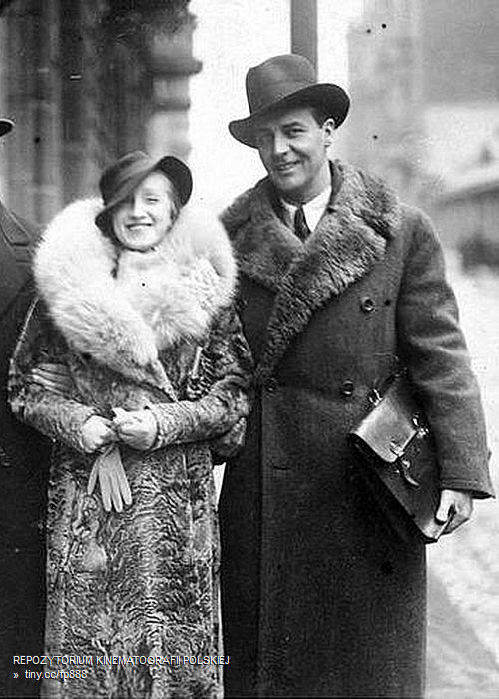
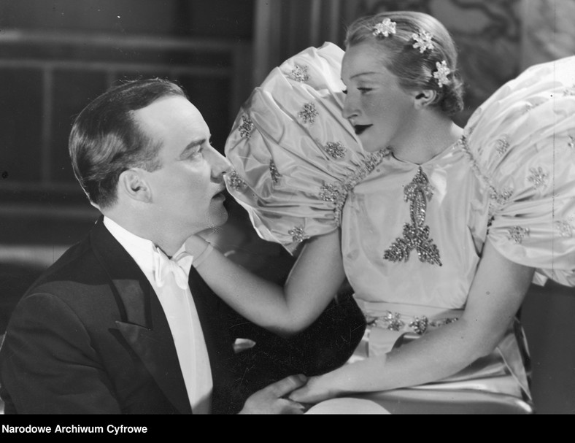
During the war the artist was arrested and imprisoned in the Pawiak prison. Her stage partner Iwo Sym, who collaborated with the Gestapo, betrayed her. Her husband bought her out of prison, and together they went to Lithuania to the Tyszkiewicz family estate.

Slide 11
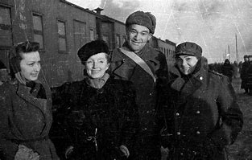
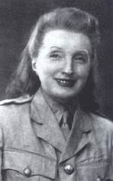
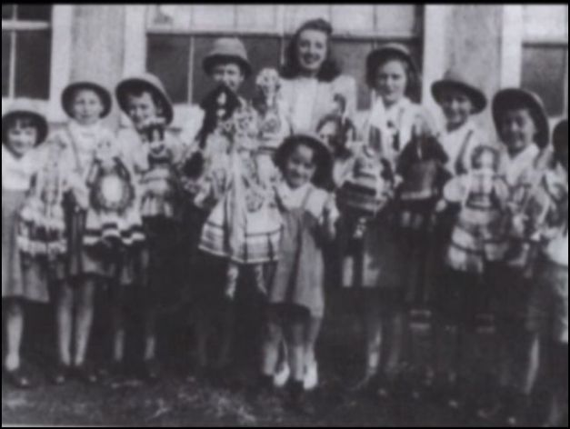
Ordonka did not enjoy her freedom for long, first the Soviets arrested her husband, then she was caught by NKWD. She was deported to a gulag in Russia.
After leaving the gulag she started to take care of orphans of the Polish who were murdered by the Russians. She managed to save 200 children, whom she later transported to Beirut.

Slide 12
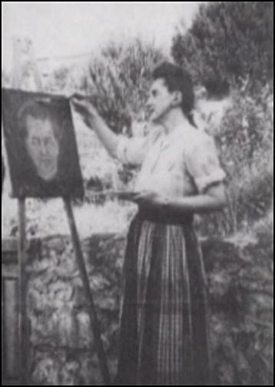
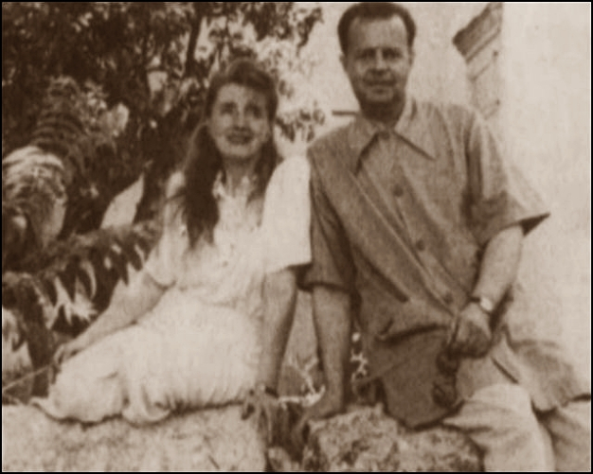
Her last years she spent in Beirut, she was very sick with lungs problems.
She died in Beirut, Lebanon in 1950, her husband was with her.

Slide 13
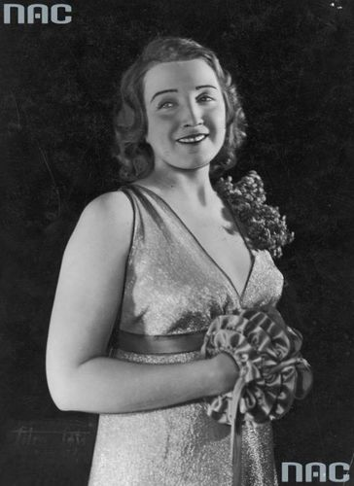
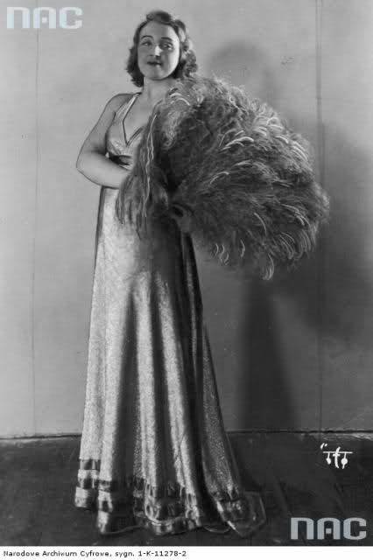
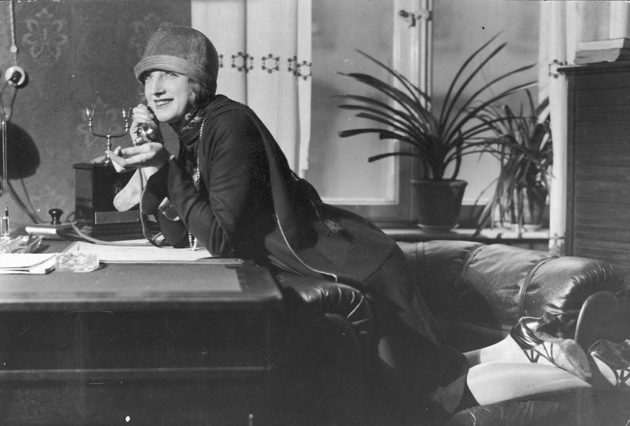
Throughout her life she emphasized her charismatic personality. She wore low-cut dresses, and was one of the first women in Poland to wear trousers.

Slide 14
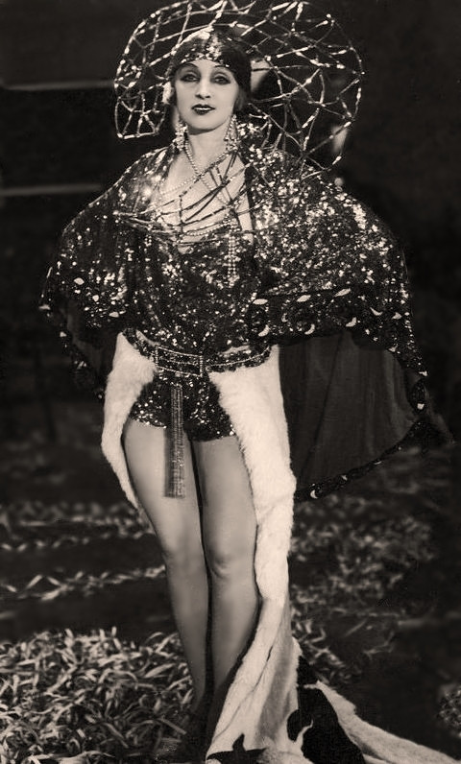
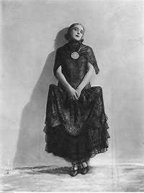
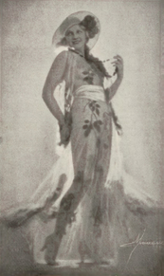
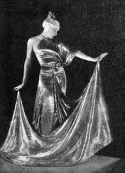
She designed most of her stage costumes herself.

Slide 15
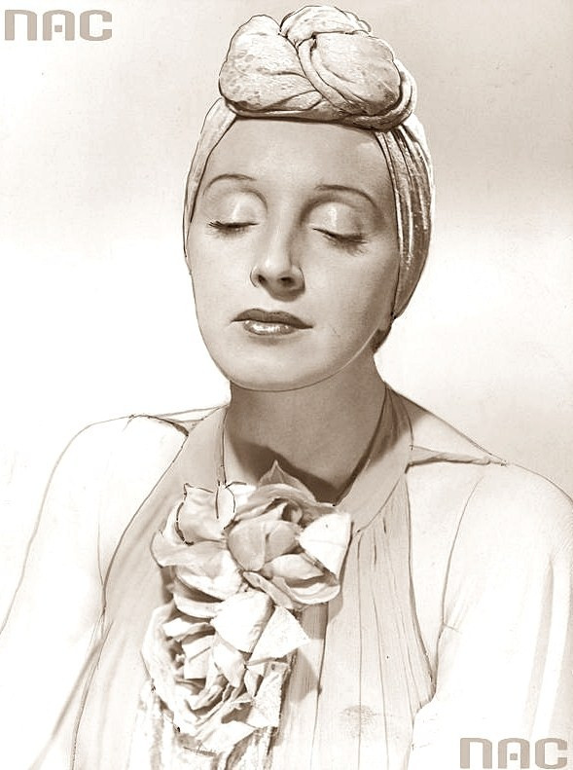
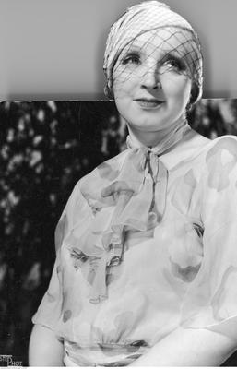
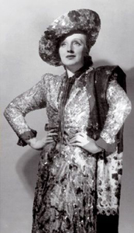
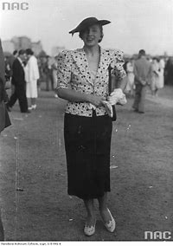
She wore her hats sideways.
Thus, she created a fashion for this type of a hat.

Slide 16
She lived exactly as she sang in her greatest hit:
Love forgives you everything.
Sorrow will turn you into laughter.
Love explains so beautifully:
Betrayal and lies and sin.
Even if you curse her in despair,
That it is cruel and evil,
Love always forgives you everything.
Because love, my beloved, love is me.

