Slide 1
ILON WIKLAND
An Estonian-Swedish artist and illustrator

Slide 2
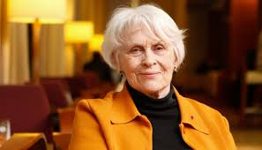
Marie-Ilon Wikland
born in 1930 in Tartu, Estonia
raised in Haapsalu, Estonia
https://lood.delfi.ee/eestinaine/raamat/ilon-wiklandi-saatuslik-kohtumine-astrid-lindgreniga?id=79886980

Slide 3
Emigration
In 1944 escaped from the second Soviet occupation of Estonia to Sweden.
She applied for a job as an illustrator and met Astrid Lindgren.

Slide 4
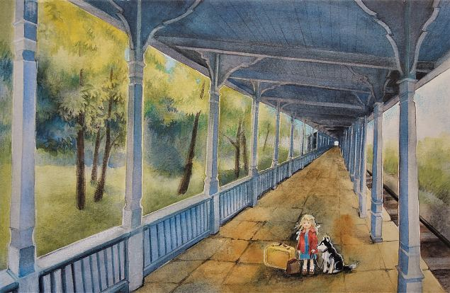
Themes of her work
In her drawings she uses motifs of Estonia, especially Haapsalu – the place in Western Estonia where she was raised.
In 2004 she decided
to give her original
artwork to Estonia as a gift.
https://www.e-kunstisalong.ee/Vaike_tudruk_laheb_suurde_maailma_Ilon_Wikland_6532

Slide 5
Her book illustrations
She was able to draw fairytales.
She has illustrated the greatest number of Astrid Lindgren`s books
https://www.raamatuvahetus.ee/bullerby-lapsed/9789949144556

Slide 6
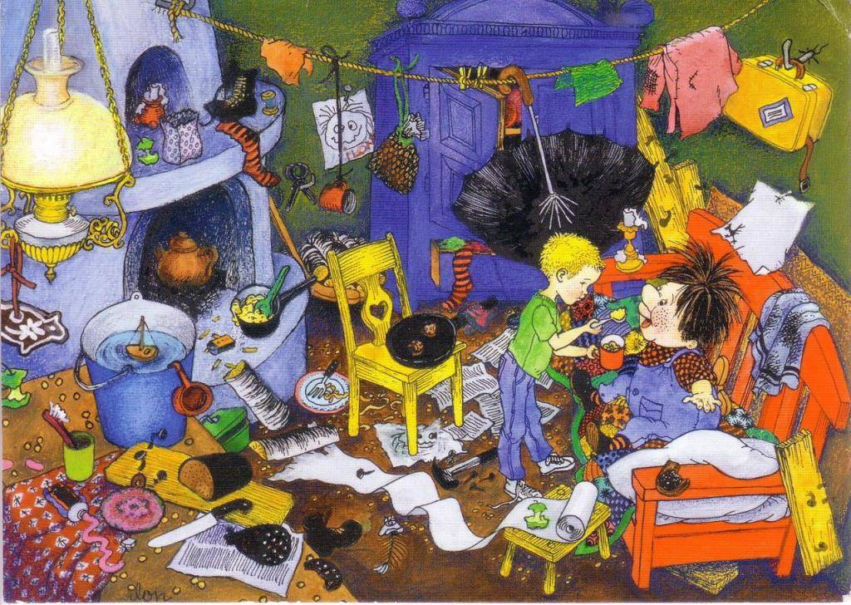
Ilon Wikland's illustrations
to Astrid Lindgren’s book
“Karlsson-on-the- Roof“
Ilon Wikland's illustrations
to Astrid Lindgren’s book
“Karlsson-on-the- Roof“
https://estonianworld.com/culture/ilon-wikland-is-in-the-hearts-of-estonians/

Slide 7
Illustrated books
The Six Bullerby Children
Karlsson-on-the-Roof
Ronia the Robber`s Daughter
The Brothers Lionheart
Mio, My Son

Slide 8
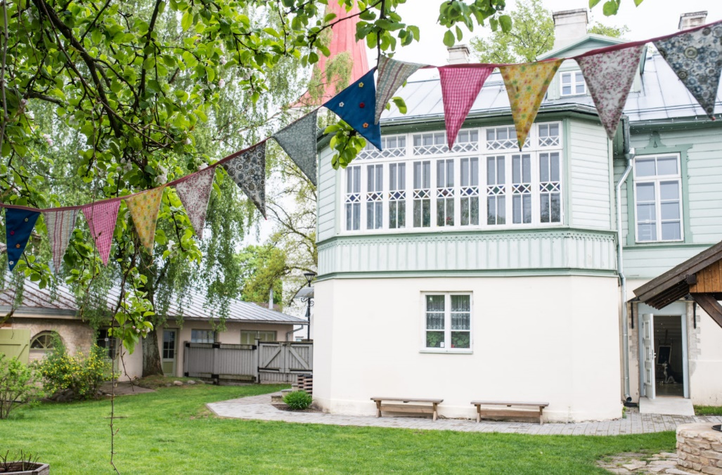
Ilon’s Wonderland
On 1 July 2009
a museum based on
Ilon’s work was opened
in Haapsalu.
It offers enjoyment for
children as well as for the
whole family.
https://www.salm.ee/wp-content/uploads/2015/07/MKL-090-700x461@2x.jpg

