Slide 1
Our Unknown HERoine: Agni Mpaltsa
Profession: Opera singer
Place of birth: Lefkada
Age: 76 years old

Slide 2
Biography
She was born on November 19, 1944 in Lefkada.
At the age of 6 she started taking piano lessons, while she started composing her own music at the age of 8.
She used to sing at the choir of ‘Orfeas’, a Union of Music and Philology in Lefkada, and took part in its concerts as a chorister and solist.
Unknown HERoines

Slide 3
Biography
Her father was a merchant. She inherited her talent from her mother, who had an excellent voice.
She is married to her colleague, Gunter Misenhard.
She has been away from Greece for 25 years, she has lived in London and Vienna and has travelled all over the world. However, she considers Greece her home, and the most beautiful country in the world.
Unknown HERoines

Slide 4
Studies
She began her studies in the Athens Greek Conservatory, form which she graduated in 1965.
In January 1965 she was awarded the ‘Maria Kallas’ scholarship in Athens. She continued her studies at the Munich Music Academy and the Frankfurt studio opera.
Apart from vocal studies, she also studied acting and German literature.
Unknown HERoines

Slide 5
The road to international recognition
Her first appearance was with the role of ‘Kerubino’ at the opera “Figaro’s Weddings”, at the Frankfurt Opera (where she sang from 1968 till 1972).
In 1973 she works together with Herbert von Karajan for the recording of “Missa Solemnis” by Beethoven, and also for Mozart’s “Coronation Ceremony” and Bruckner’s “Te Deum” in 1975. Two years later, they open the Salzburg Festival with “Salome”. The conductor and his ‘Herodiad’ will continue to work together for the next 15 years.
Unknown HERoines

Slide 6
The road to international recognition
They return to Salzburg in 1986 with a historic performance: she sings the role of ‘Eboli’ in Verdi’s “Don Carlo”. Many more conductors will follow at the podium, among them Ricardo Mutti, Bernstein, Abado.
She first appears at the Paris Opera and the New York Metropolitan in 1980, singing “Karmen”, one of her most successful roles. The audience and critics were full of enthusiasm.
Unknown HERoines

Slide 7
The road to international recognition
She also played a role in the German “Duett” in 1992, acting as an opera singer.
A unique career followed, with appearances at the most famous theaters worldwide: Berlin German Opera, Vienna State Opera, New York Metropolitan Opera, Bavaria State Opera, London Royal Opera, Milan Opera, Paris Opera etc., and many times at the Salzburg Festival.
Unknown HERoines

Slide 8
The road to international recognition
Many concert tours have led her even to Far East countries, like Japan and Korea. Her list of roles performed reminds us of a feature with the history of opera!
Her broad repertoire includes, among others, Mozart, Rossini, Bellini, Verdi, Strauss, Wagner. Moreover, she has been the most popular ‘Karmen’ for 20 whole years (1970/90).
She has been honoured with many distinctions, and has a rich discography.
Unknown HERoines

Slide 9
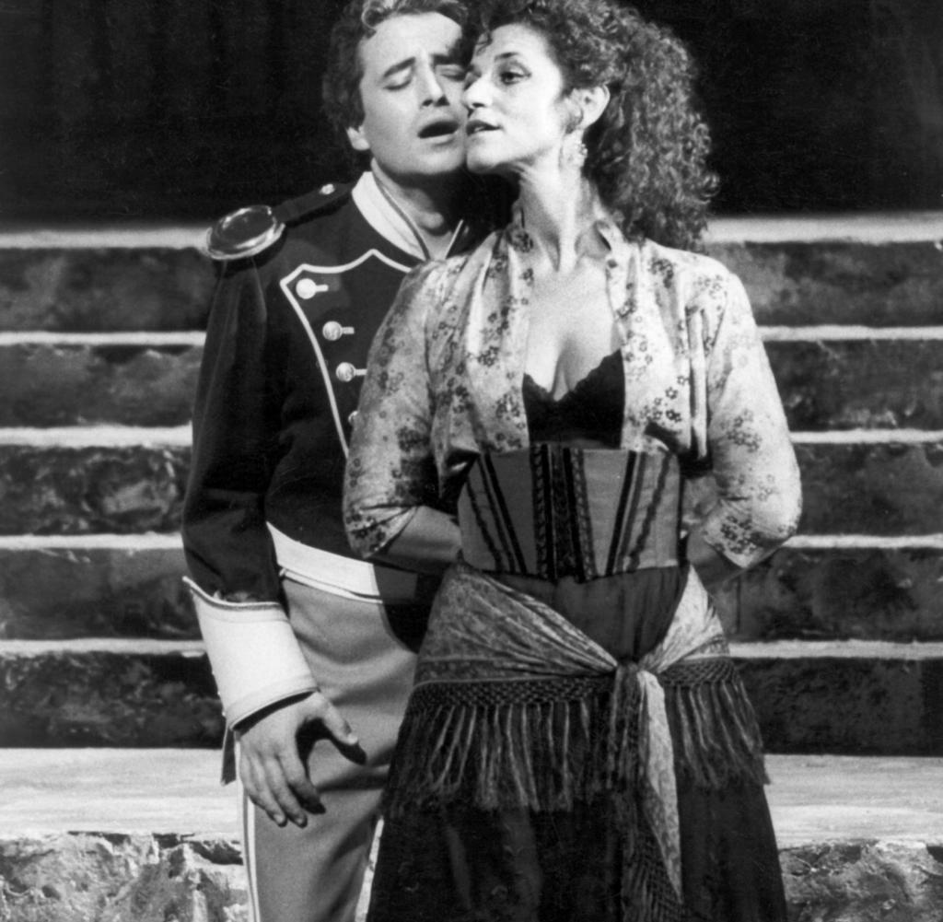
‘Karmen’, with Jose Carreras (Salzburg, 1985)
Unknown HERoines

Slide 10
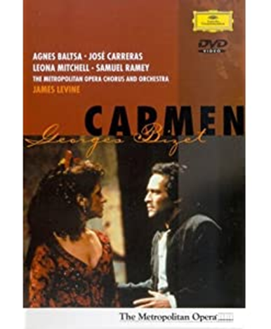
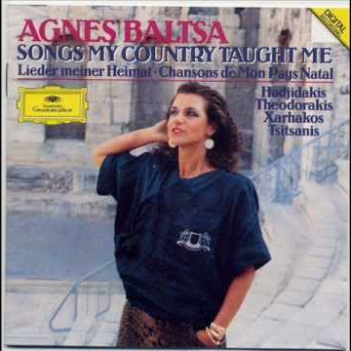
Her return to Greece and her collaborations
In 1984 she first appears in Greece as ‘Karmen’ with the Zurich Opera, with Jose Carreras at her side as ‘Don Jose’.
She also has a collaboration with the Greek composer Stavros Xarhakos in 1985. They produced a record which was launched by Deutshe Grammophon titled «Songs my country taught me», and contained songs from great Greek composers.
Unknown HERoines

Slide 11
Her return to Greece and her collaborations
With Mikis Theodorakis as conductor, she sang in 1992 at the opening ceremony of the Barcelona Olympic Games, during the entrance of the Olympic flag in the stadium.
In 1996, at the Atlanta Olympic Games, she sang again the “Songs my country taught me”, with Stavros Xarhakos as conductor.
Unknown HERoines

Slide 12
Her return to Greece and her collaborations
On May 17th 2012 she sang the Greek National Anthem at the Panathenean Stadium, during the ceremony for the delivery of the Olympic Flame for the London Olympic Games.
Her last appearance was in 2017, in one of the greatest operas of the early 20th century, “Electra” by Johann Strauss. She sang the role of ‘Clitemnistra’.
Unknown HERoines

Slide 13
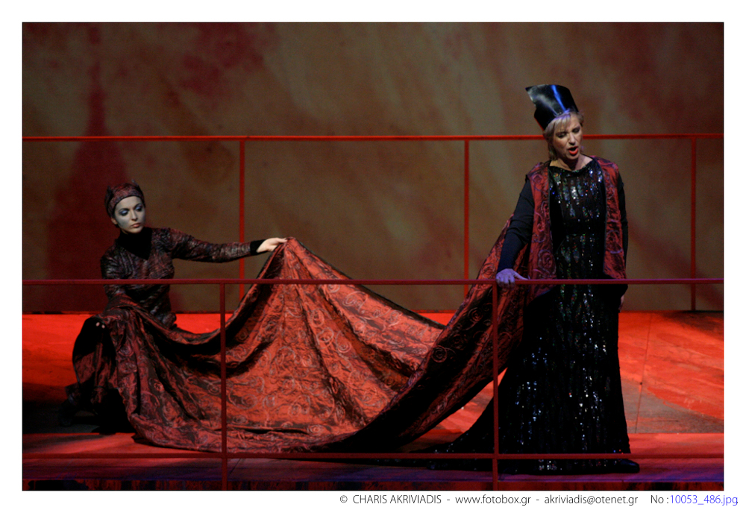
‘Electra’
Athens Music Hall, 2007
Unknown HERoines

Slide 14
Critics on her work
The German critics have called «...pearl
in Opera’s necklace», and the famous conductor Herbert von Karajan has stated «... she is the most important dramatic mezzo soprano of our time».
Unknown HERoines

Slide 15
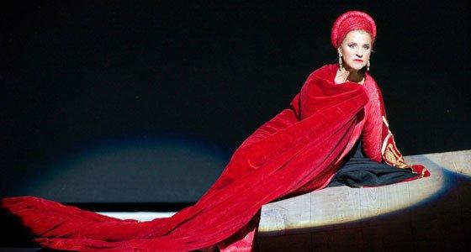
Unknown HERoines

Slide 16
Distinctions
In 1980 she was awarded the title “Österreichische Kammersängerin” by the Vienna Opera.
She has received the Golden Medal of the city of Athens.
She has also received many other distinctions, like the “Prix du Prestige Lyrique”, the “Deutscher Schallplattenpreis”, the Golden Medal of the city of Vienna.
Unknown HERoines

Slide 17
Distinctions
In 1995 she was honoured by the Greek Democracy with the ‘Phoenix Brigadier’.
Since 1988, she has been an honorary member of the Vienna Opera.
Since 1993, she has been a member of the European Art and Sciences Academy.
Unknown HERoines

Slide 18
Extracts from her interviews
«I am very grateful for the gift of my voice. I also had a fantastic family, a great teacher, I met and worked with great people... I don’t know if this was a coincidence, but for me it was luck. I was also lucky to be born with my mind: it didn’t let my talent go to waste, and protected me from overestimating my powers»
Unknown HERoines

Slide 19
Extracts from her interviews
«You see, I received many dangerous offers at a young age. I believe that, at the right moment, I thought things through in the right way. I took 3 steps ahead and 2 backwards, so as to estimate the situation and achieve self-focus And I have said it before: I always remained a student»
Unknown HERoines

Slide 20
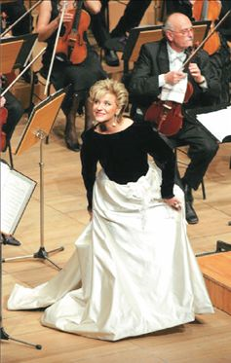
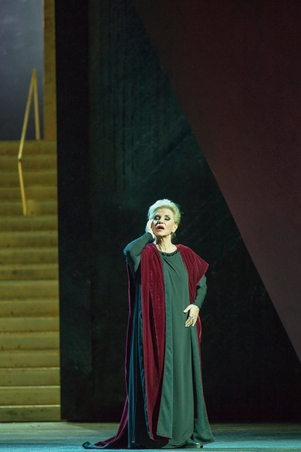
Unknown HERoines

Slide 21
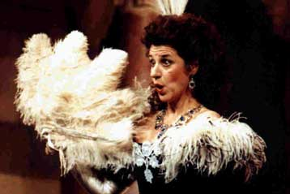
Discography
«Askanios in Alba» 1976
«The Magic Flute» 1980
«Cosi Fann’ Tutti» 1982
«Idomeneas» 1983
«Figaro’s Weddings» 1985
«Don Giovanni» 1985
«Mithridatis, King of Pontos» 1991
«The Seville Barber»
«Cinderella»
«Italian Woman in Algiers» (photo)
«Mary Stuart»
Unknown HERoines

Slide 22
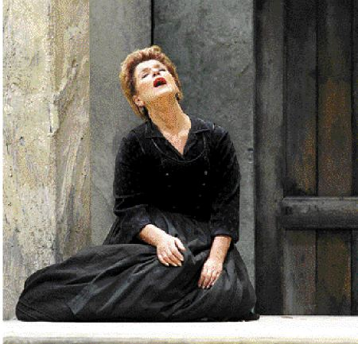
Discography
«The Little Bell»
«Capulets and Montagues»
«Sampson and Dalida»
«Cavalerria Rusticana» (photo)
«Gioconda»
«Aida»,
«Don Carlo»
«The Knight with the Rose»
«Salome»
«Carmen»
«Bat»
She has sang songs by Manos Hadjidakis, and has been on tours with Stavros Xarhakos.
Unknown HERoines

Slide 23
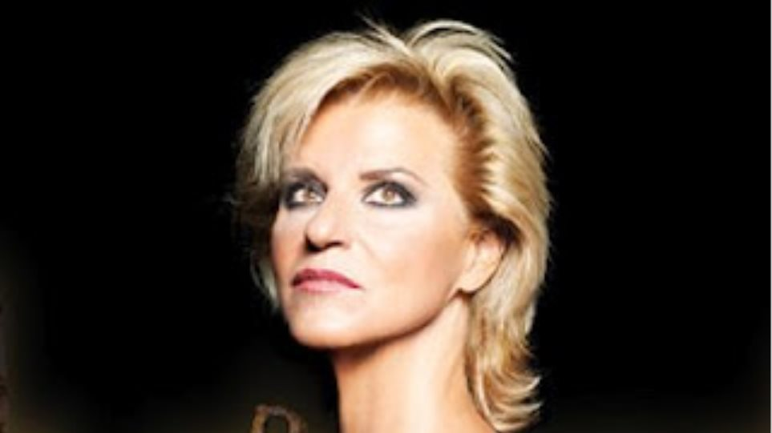
Agni Baltsa as ‘Carmen’
https://youtu.be/ZJtyVUAP3ak
Unknown HERoines

Slide 24
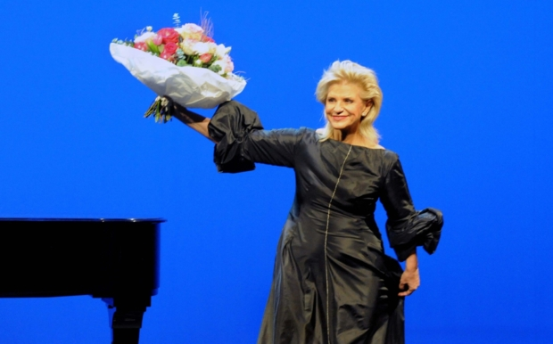
Agni of our hearts
When we talk of Agni Baltsa, we don’t only discuss her marvelous voice, her impeccable technique, her commanding stage presence, her interpretative genius and her temperament. We also talk about a person who left her mark in opera, a woman with soul, spirit, courage and unbelievable vitality, an artist of total international recognition.
Unknown HERoines

Slide 25
Sources
For this presentation, information and photos were taken from the Internet:
(1) wikipedia.org
(2) www.hellenicaworld.com
(3) www.lefkastour.gr
(4) www.tanea.gr
(5) www.kathimerini.gr
(6) www.tralala.gr
Unknown HERoines

Slide 26
Thank you for your patience and attention!!!
Unknown HERoines

