Slide 1
Unknown HERoines INTRODUCTION
When it comes to science in the world, male names usually come to mind.
Although this prejudice is broken a little more every year, it cannot be completely eradicated.
«Unknown HERoines»

Slide 2
Unknown HERoines INTRODUCTION
So how many people know about female scientists?
Two Nobel Laureates Marie Curie?
Ada Lovelace, a mathematician and considered the world's first computer programmer by some circles?
Christina Koch, who performed the second longest spaceflight in NASA history?
«Unknown HERoines»

Slide 3
Unknown HERoines INTRODUCTION
What about Turkish female scientists?
Even though it is less compared to previous years, women today are still struggling with their success being taken to the second plan, being forgotten, and worse still not noticed.
«Unknown HERoines»

Slide 4
Unknown HERoines INTRODUCTION
The place of women in science and engineering is still met with "astonishment", and the name of the man is emphasized more in difficult conditions.
Women struggle extra to show themselves in challenging professions.
«Unknown HERoines»

Slide 5
Unknown HERoines INTRODUCTION
However, many women are leaving their marks in the world by overcoming difficulties and giving direction to the world with the steps they take in their professions.
«Unknown HERoines»

Slide 6
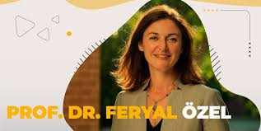
Unknown HERoines INTRODUCTION
We wanted to remind the Turkish scientists who left their mark on science and talked to the world.
Here is Prof.Dr.Feryal OZEL, one of the scientists who made Turkey proud with her work
«Unknown HERoines»

Slide 7
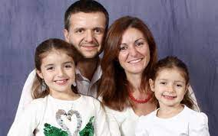
BIOGRAPHY
feryal Özel (born May 27, 1975) is a Turkish-American astrophysicist born in Istanbul, Turkey, specializing in the physics of compact objects and high energy astrophysical phenomena.
«Unknown HERoines»

Slide 8
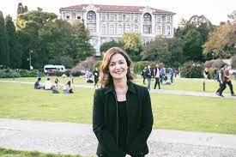
BIOGRAPHY
As of 2020, Özel is a professor at the University of Arizona in Tucson, in the Astronomy Department and Steward Observatory.
«Unknown HERoines»

Slide 9
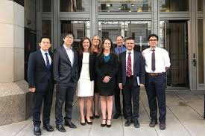
Özel received her PhD at Harvard University with Ramesh Narayan acting as Thesis advisor.
«Unknown HERoines»

Slide 10
She was a Hubble Fellow and member at the Institute for Advanced Study in Princeton, New Jersey.
«Unknown HERoines»

Slide 11
She was a Fellow at the Harvard-Radcliffe Institute and a Visiting Professor at the Miller Institute at UC Berkeley.
«Unknown HERoines»

Slide 12
Özel is widely recognized for her contributions to the field of neutron stars, black holes, and magnetars.
«Unknown HERoines»

Slide 13
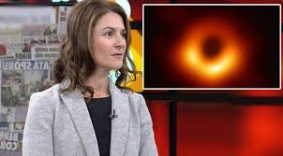
She is a member and Modeling lead of the Event Horizon Telescope (EHT) that released the first image of a black hole.
«Unknown HERoines»

Slide 14
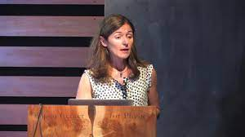
Özel received the Maria Goeppert Mayer award from the American Physical Society in 2013 for her outstanding contributions to neutron star astrophysics.
«Unknown HERoines»

Slide 15
Özel has appeared on numerous TV documentaries including Big Ideas on PBS and the Universe series in the History Channel.
«Unknown HERoines»

Slide 16
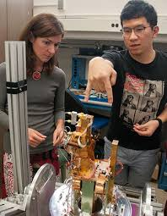
Along with Alexey Vikhlinin, Özel is the Science and Technology Definition Team Community Co-Chair for the Lynx X-ray Observatory NASA Large Mission Concept.
«Unknown HERoines»

Slide 17
Honors and awards
Breakthrough Prize, 2020
Chair, Astrophysics Advisory Committee (APAC), NASA, 2019
Fellowship, John Simon Guggenheim Memorial Foundation, 2016
Visiting Miller Professorship, University of California Berkeley, 2014
Maria Goeppert Mayer Award, American Physical Society, 2013
Fellowship, Radcliffe Institute for Advanced Studies, 2012-2013
Bart J. Bok Prize, Harvard University, 2010
«Unknown HERoines»

Slide 18
Lucas Award, San Diego Astronomy Association, 2010
Visiting Scholar Fellowship, Turkish Scientific and Technical Research Foundation, 2007
Hubble Postdoctoral Fellowship, 2002-2005
Distinguished Scholar Award, Daughters of Atatürk Foundation, 2003
Keck Fellowship, Institute for Advanced Study, 2002
Van Vleck Fellowship, Harvard University, 1999
Kostrup Prize, Niels Bohr Institute, 1997
Niels Bohr Institute Graduate Fellowship, 1996-1997
Applied Mathematics Faculty Award, Columbia University, 1996
Fu Foundation Scholarship, Columbia University, 1994-1996
Research Fellowship, CERN, 1995
Turkish Health and Education Foundation Scholarship, 1992-1994
«Unknown HERoines»

Slide 19
THANKS FOR LISTENING
You can also visit youtube for one of her speeches
https://www.youtube.com/watch?v=IFzaKvI3RPU
«Unknown HERoines»

